Slide 1
Hanwash Performance Indicator (H.P.I)

Slide 2
H.P.I console
Accessibility of the platform

Slide 3
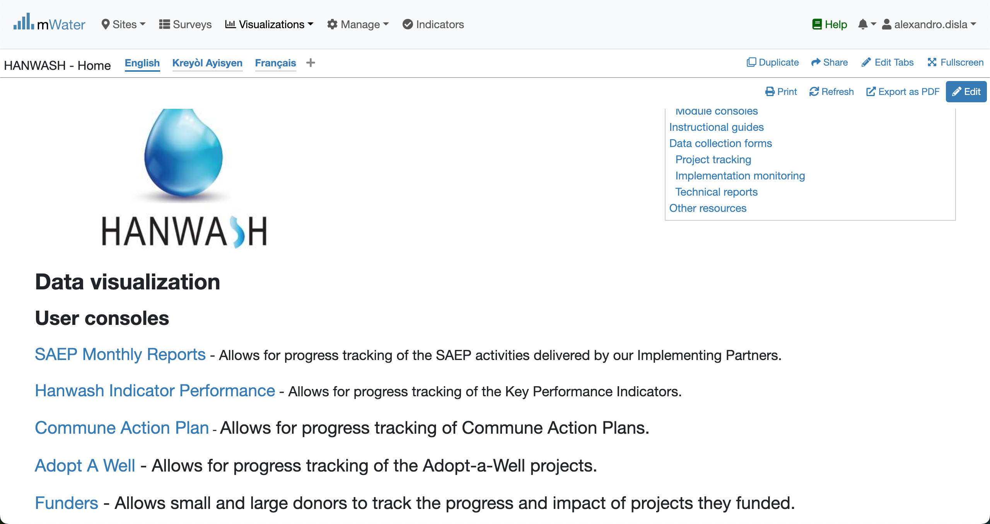
Hanwash HOME
URL LINK : http://go.mwater.co/hanwash

Slide 4
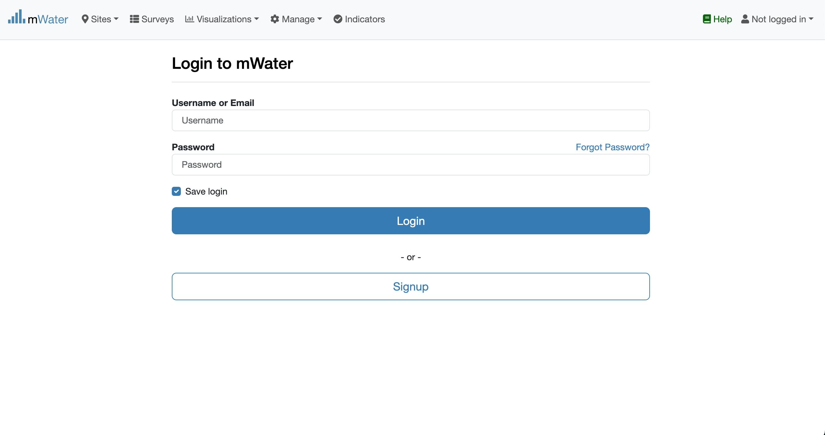
Access The H.P.I Console & Login process
Click on the H.P.I console url link
Please enter your Credentials (username ,console)
Log status indicator

Slide 5

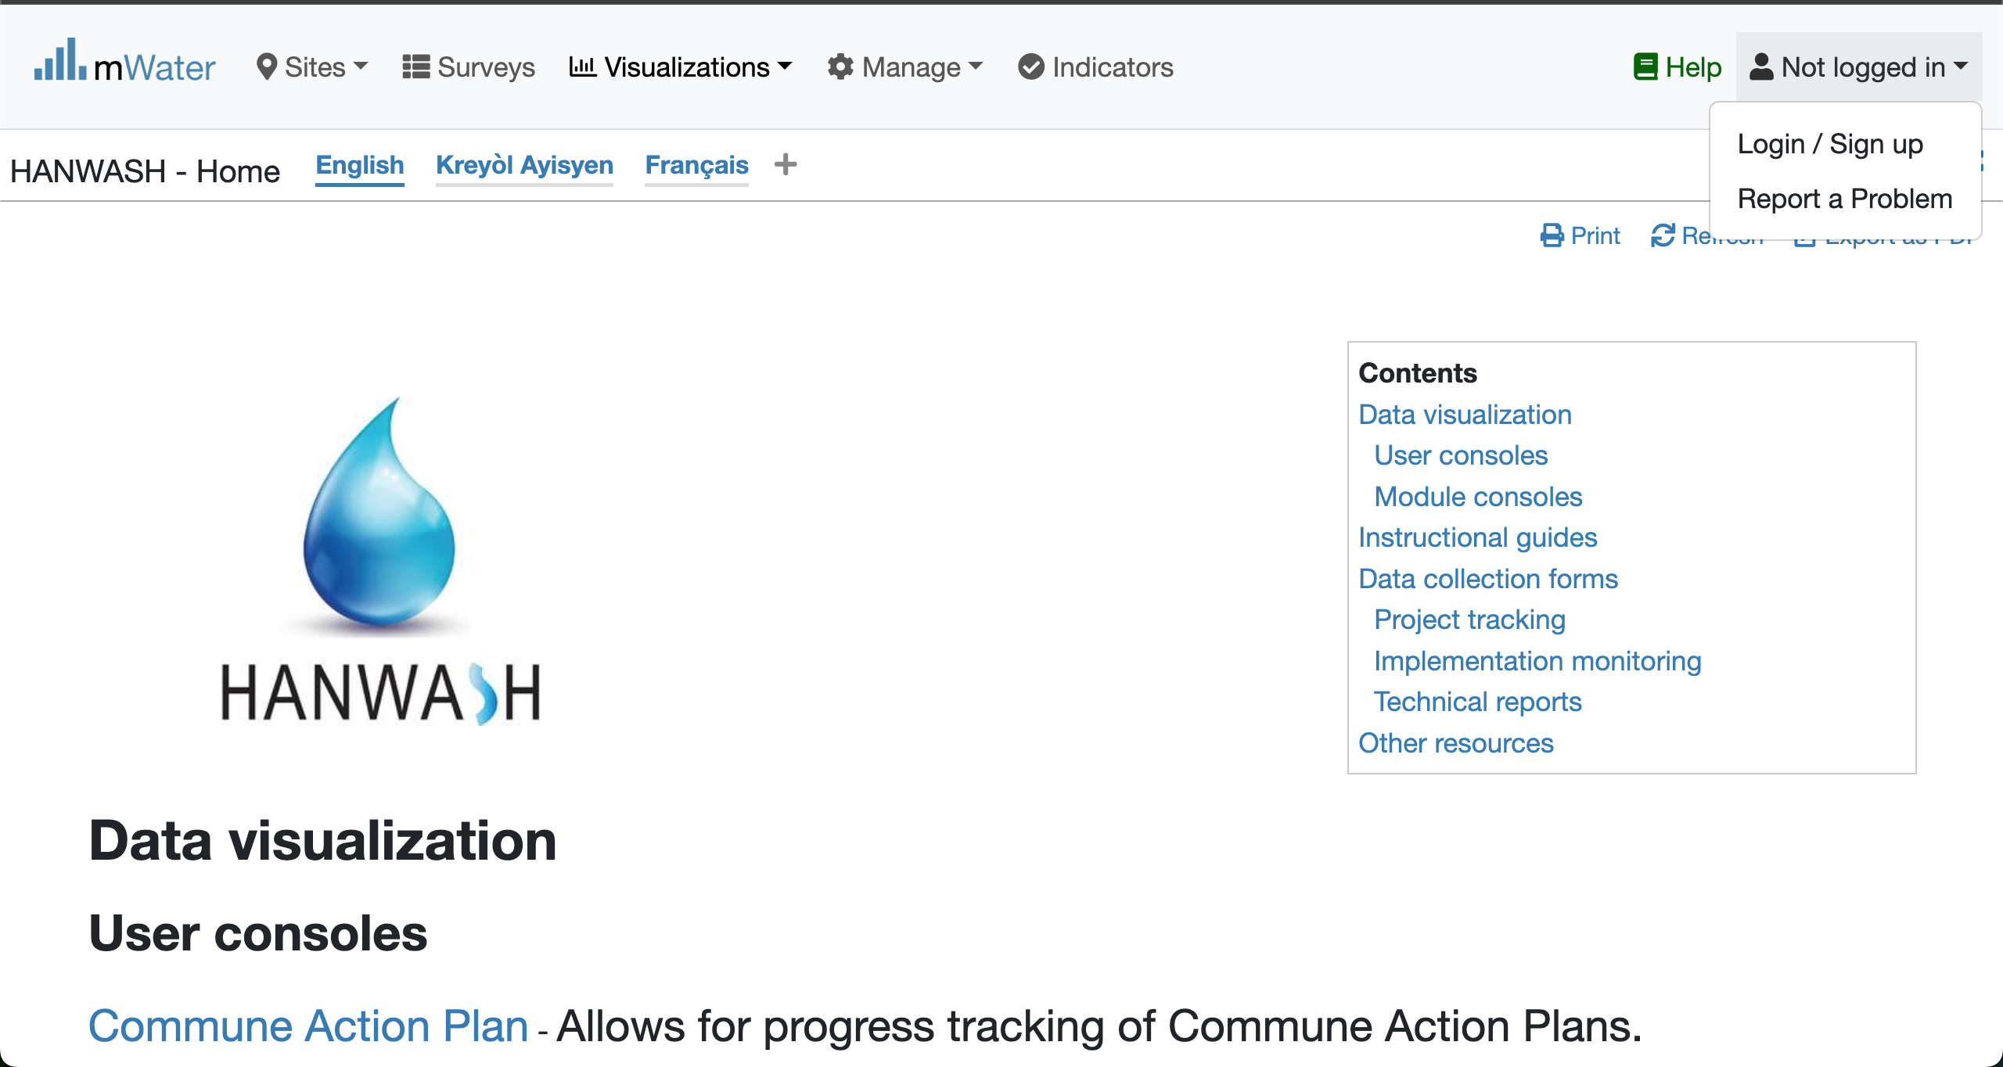


Login Process (2nd scenario)
Click to Login or Signup
Please Click on this selection box
Please enter your Credentials

Slide 6
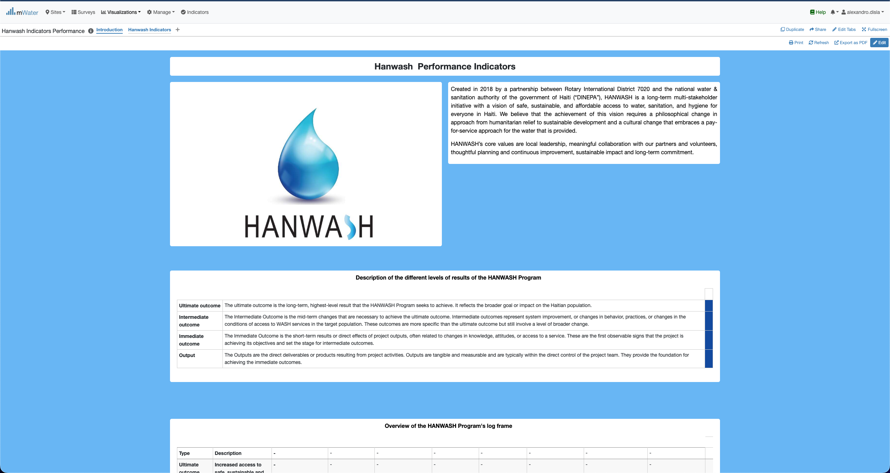
H.P.I Console overview

Slide 7
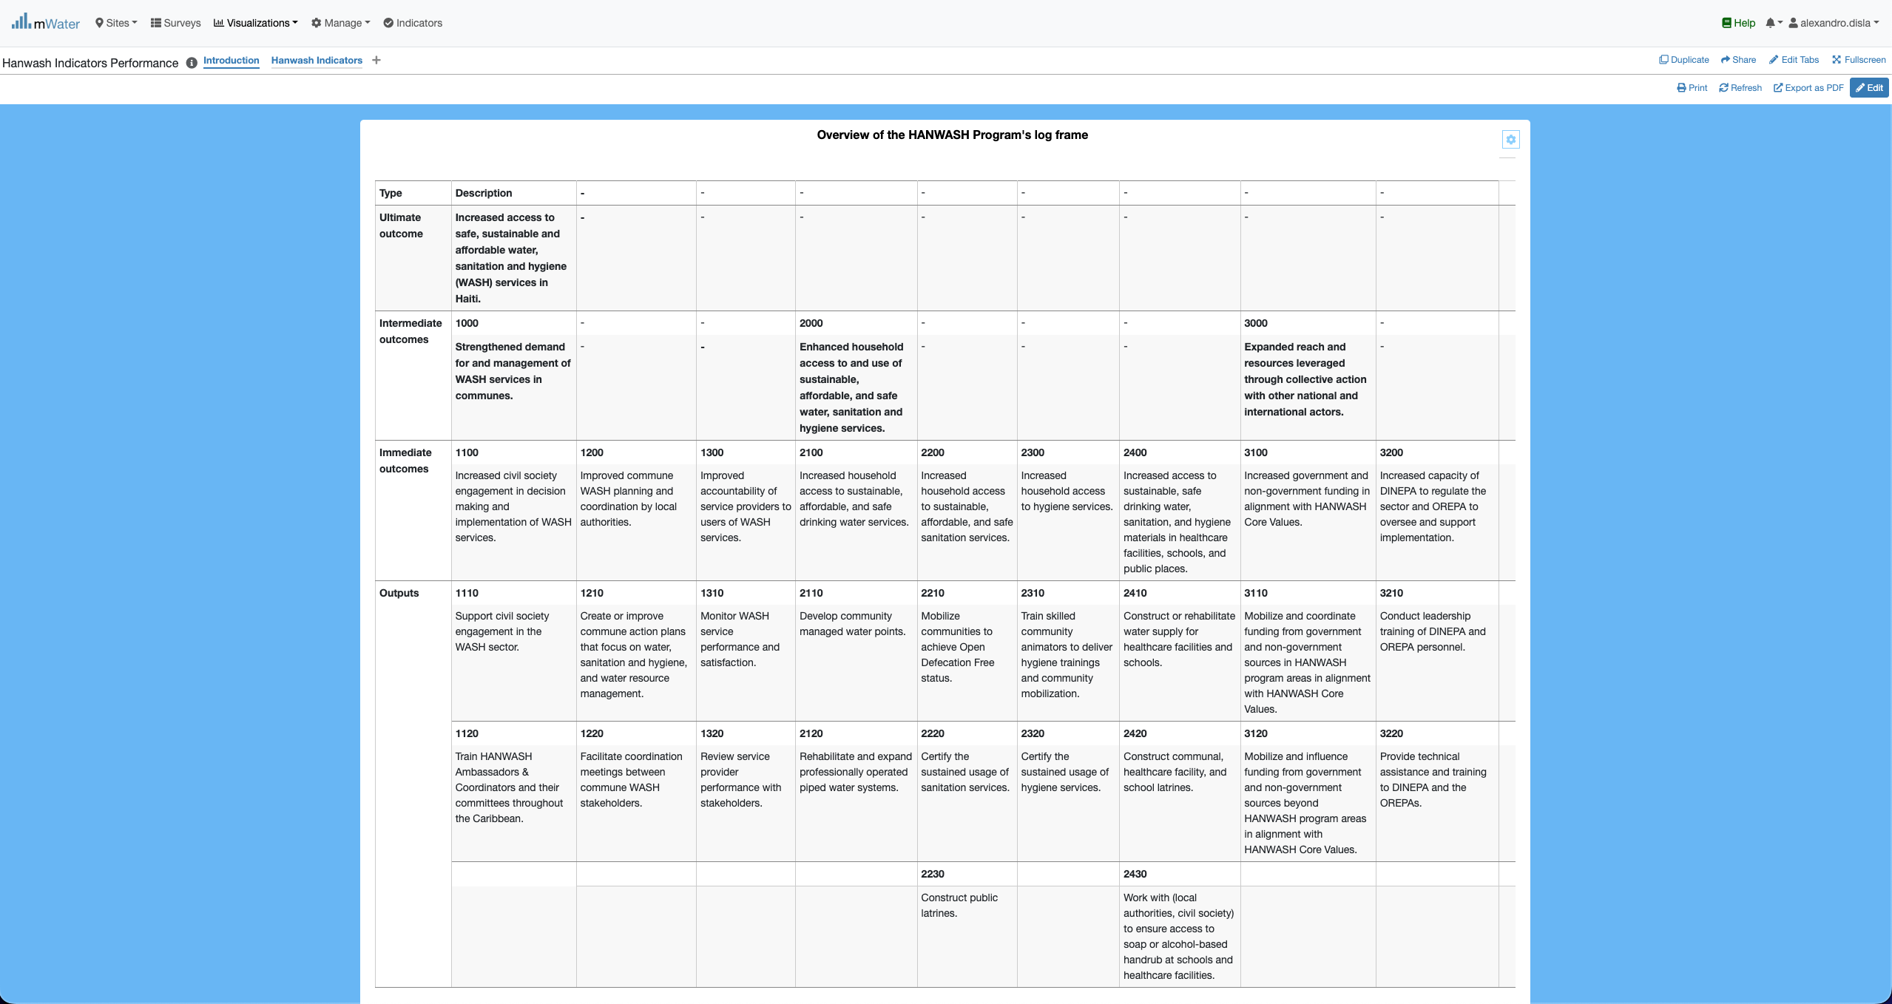
HIP Console overview

Slide 8
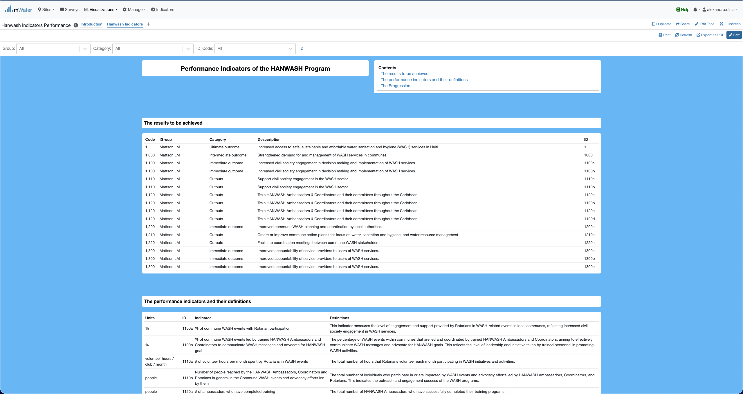
HIP Console overview

Slide 9
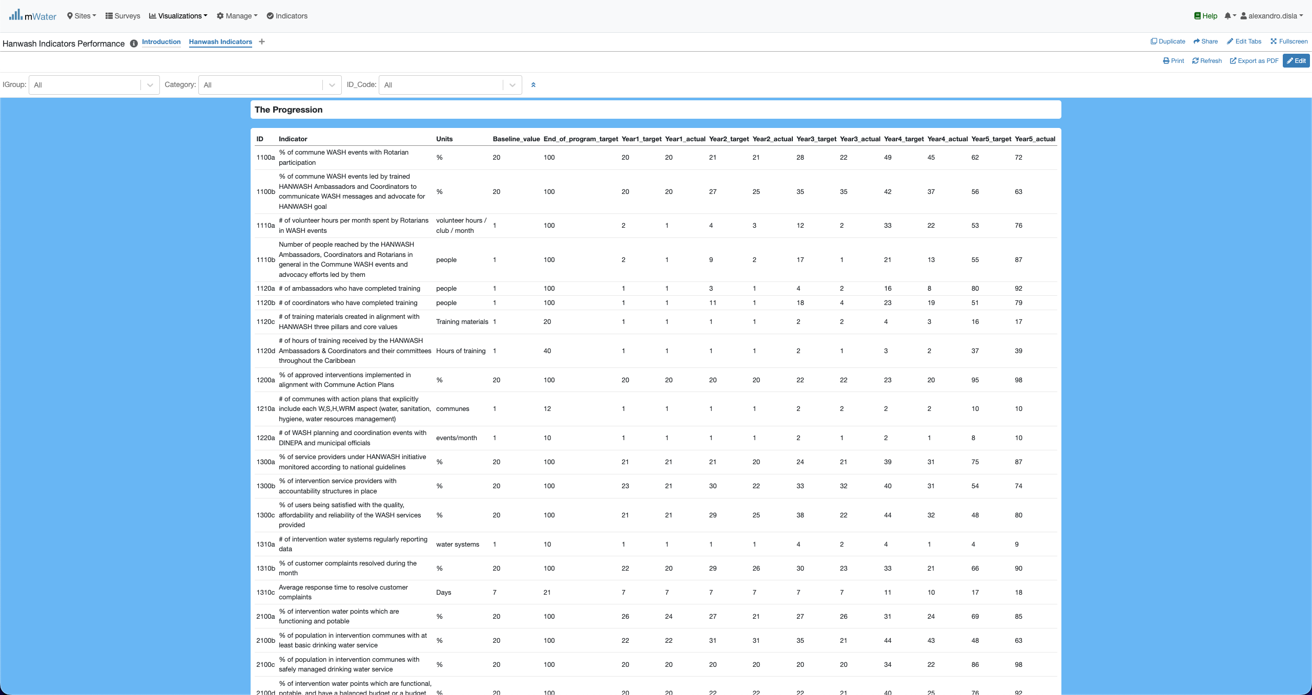
HIP Console overview

Slide 10
Functionalities
Functionalities available in the console

Slide 11
The introduction page
Introduction

Slide 12
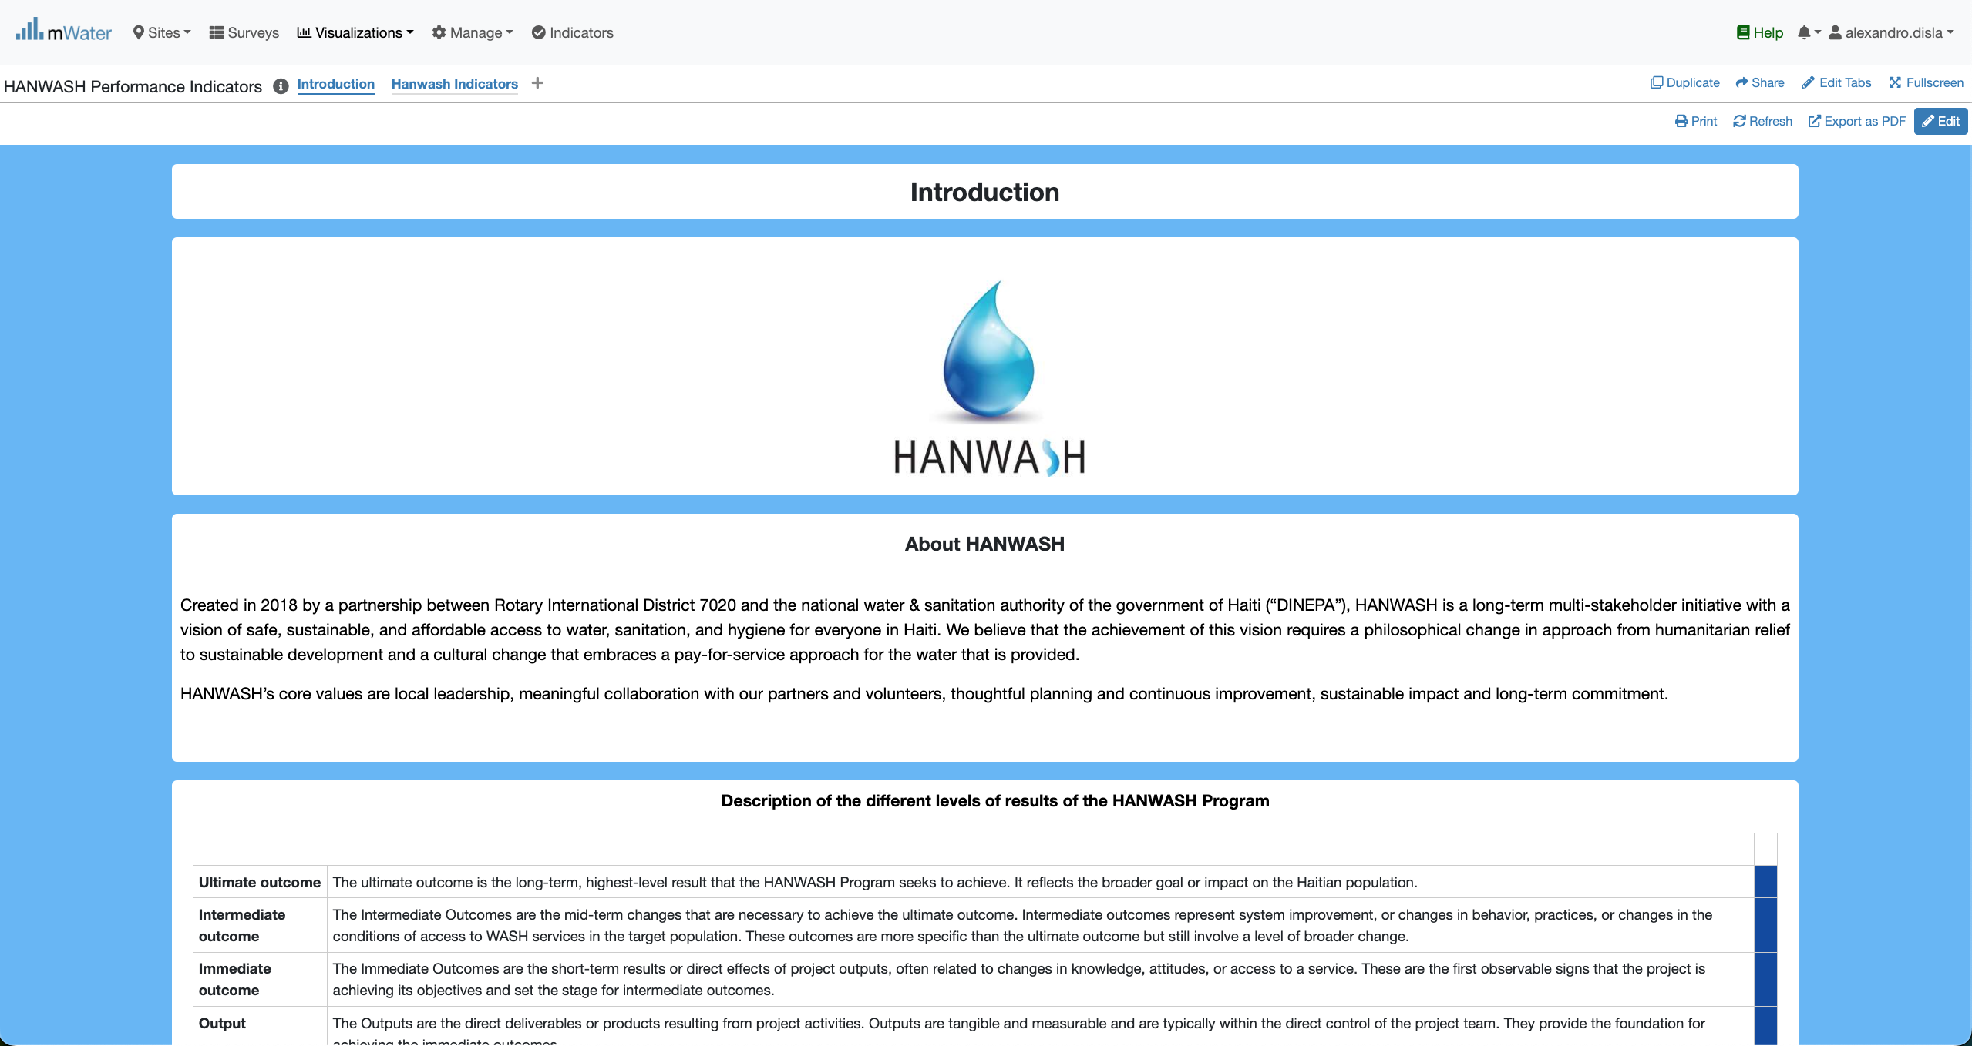
Introduction

Slide 13
Introduction
The key feature of merge and center is missing from the platform. We have place these yellow box to showcase this.

Slide 14
The Main page
Hanwash Indicators

Slide 15
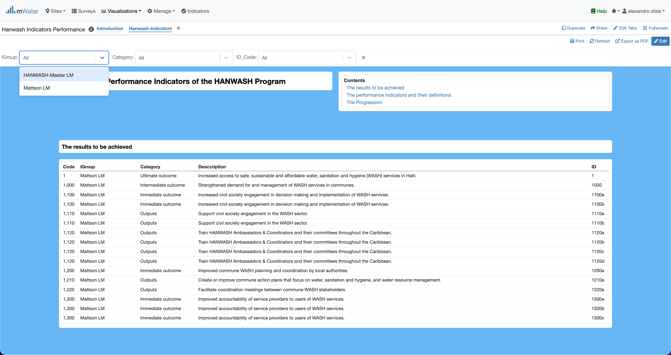
Display the quickfilters
The first filter indicate whether or not the indicator is associated with Mattson Program.

Slide 16
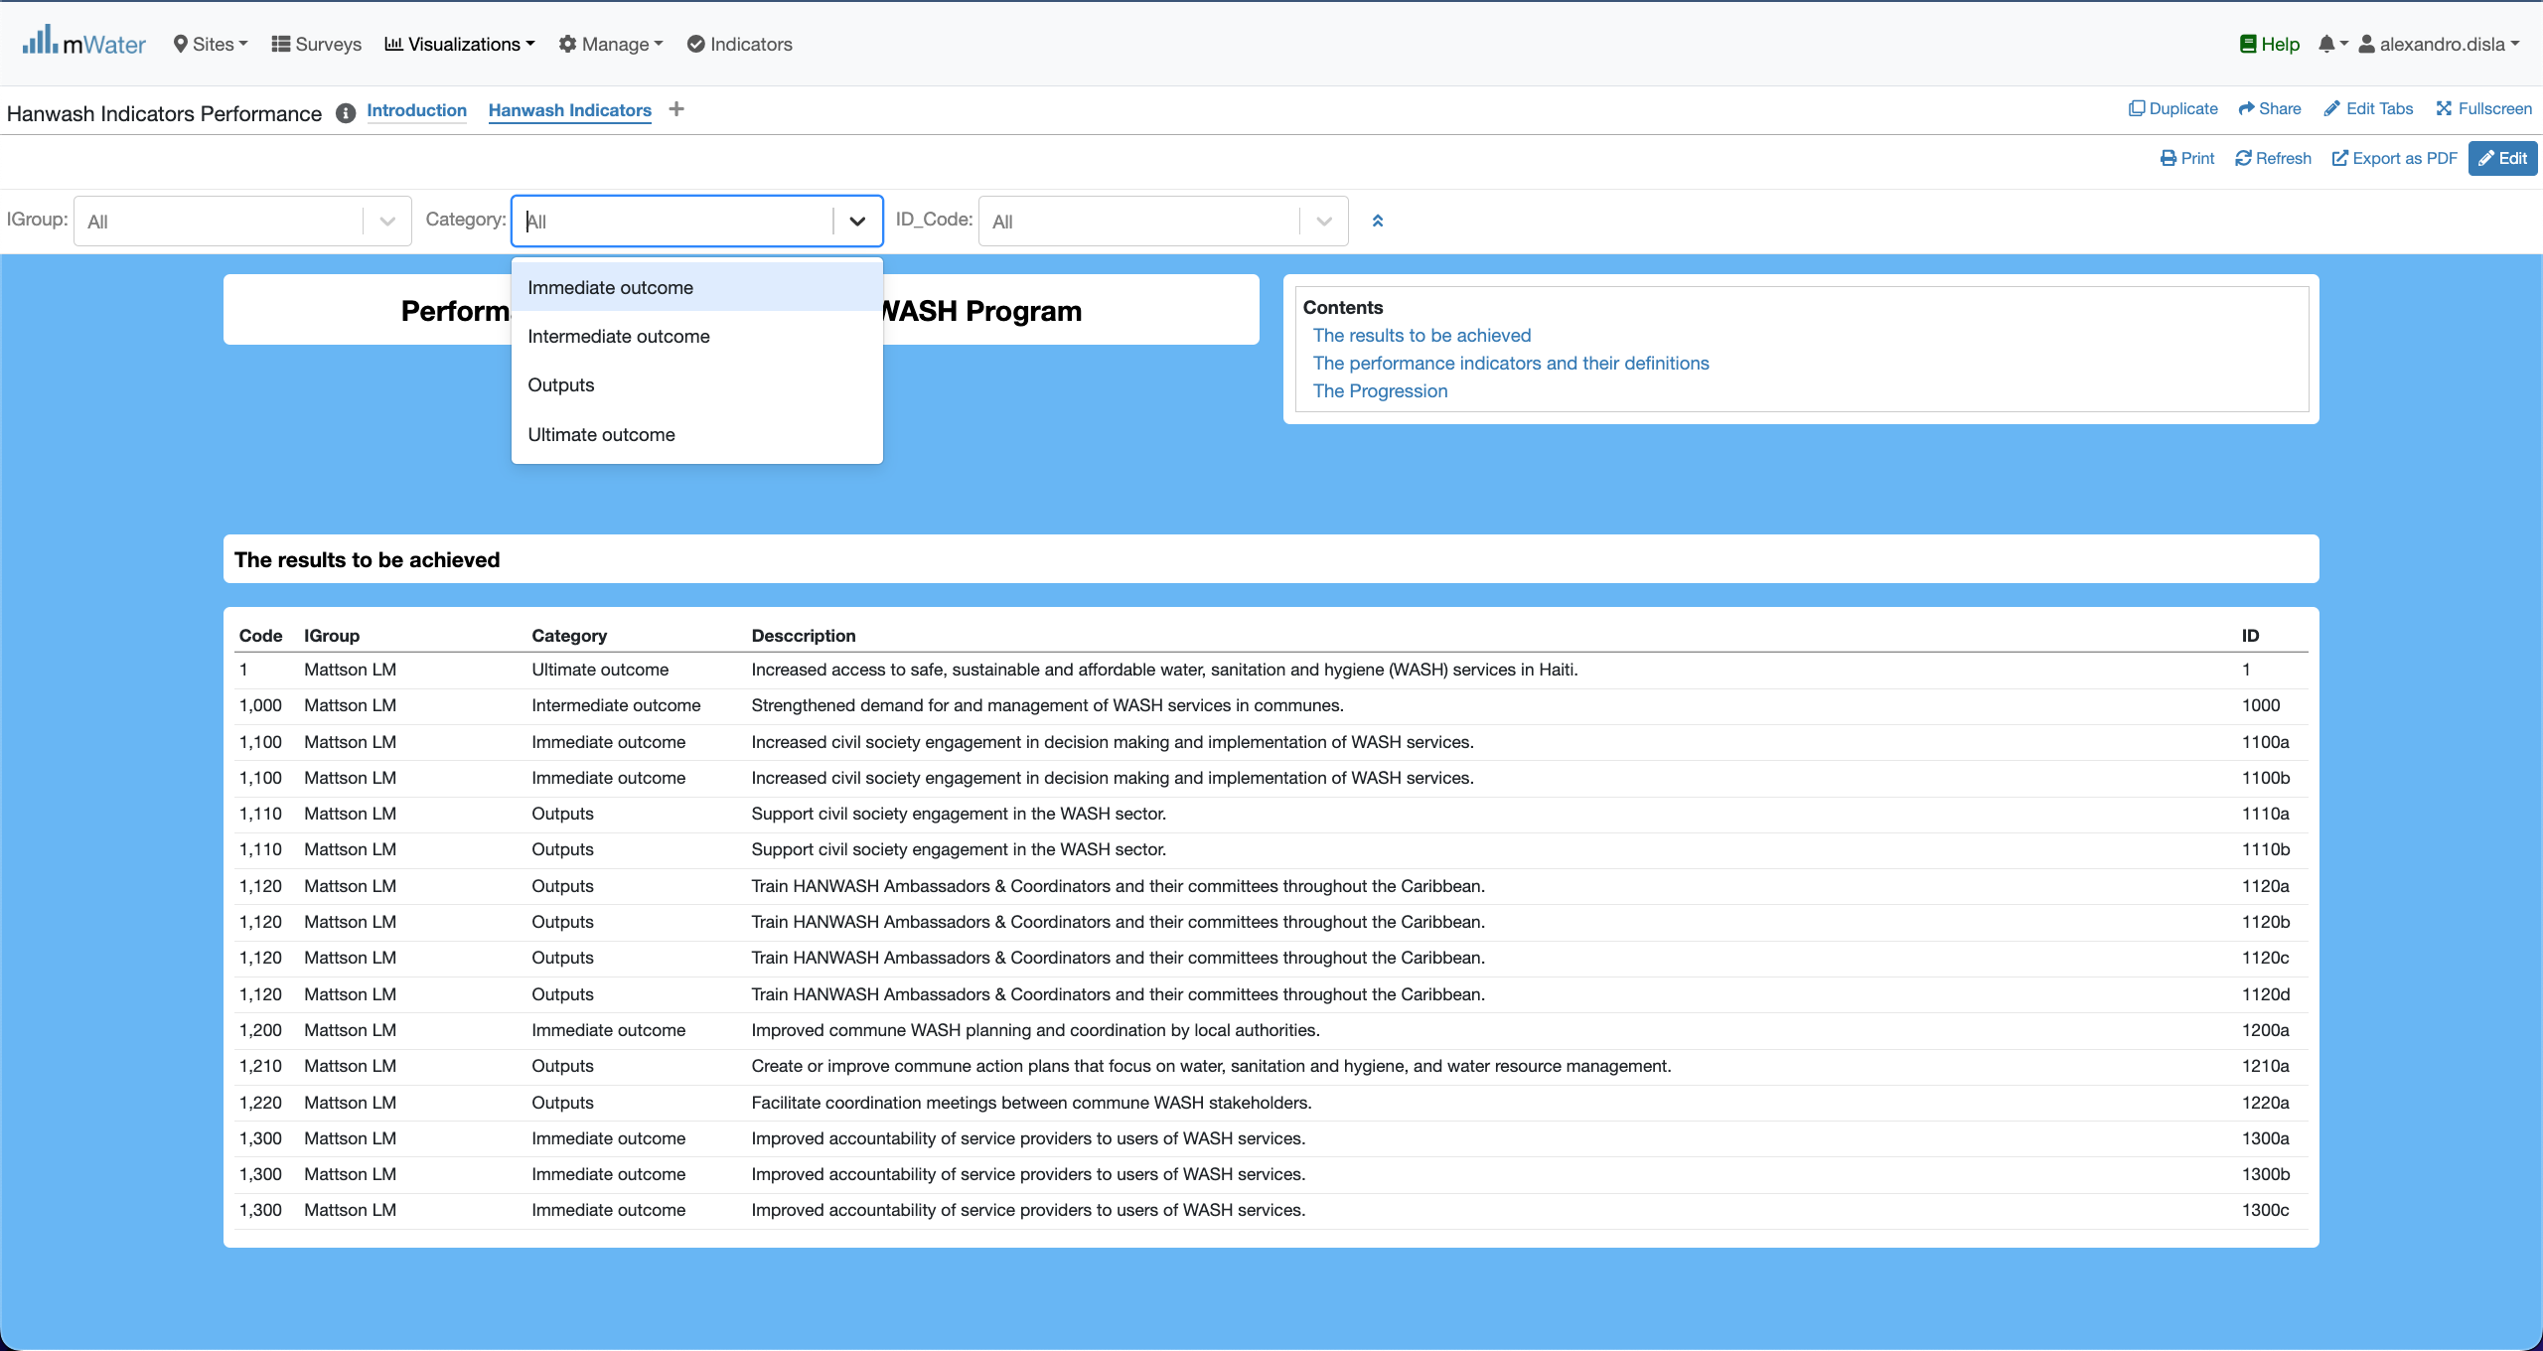
Display the quickfilters
The second filter describe the classification of the indicators by level of results.

Slide 17
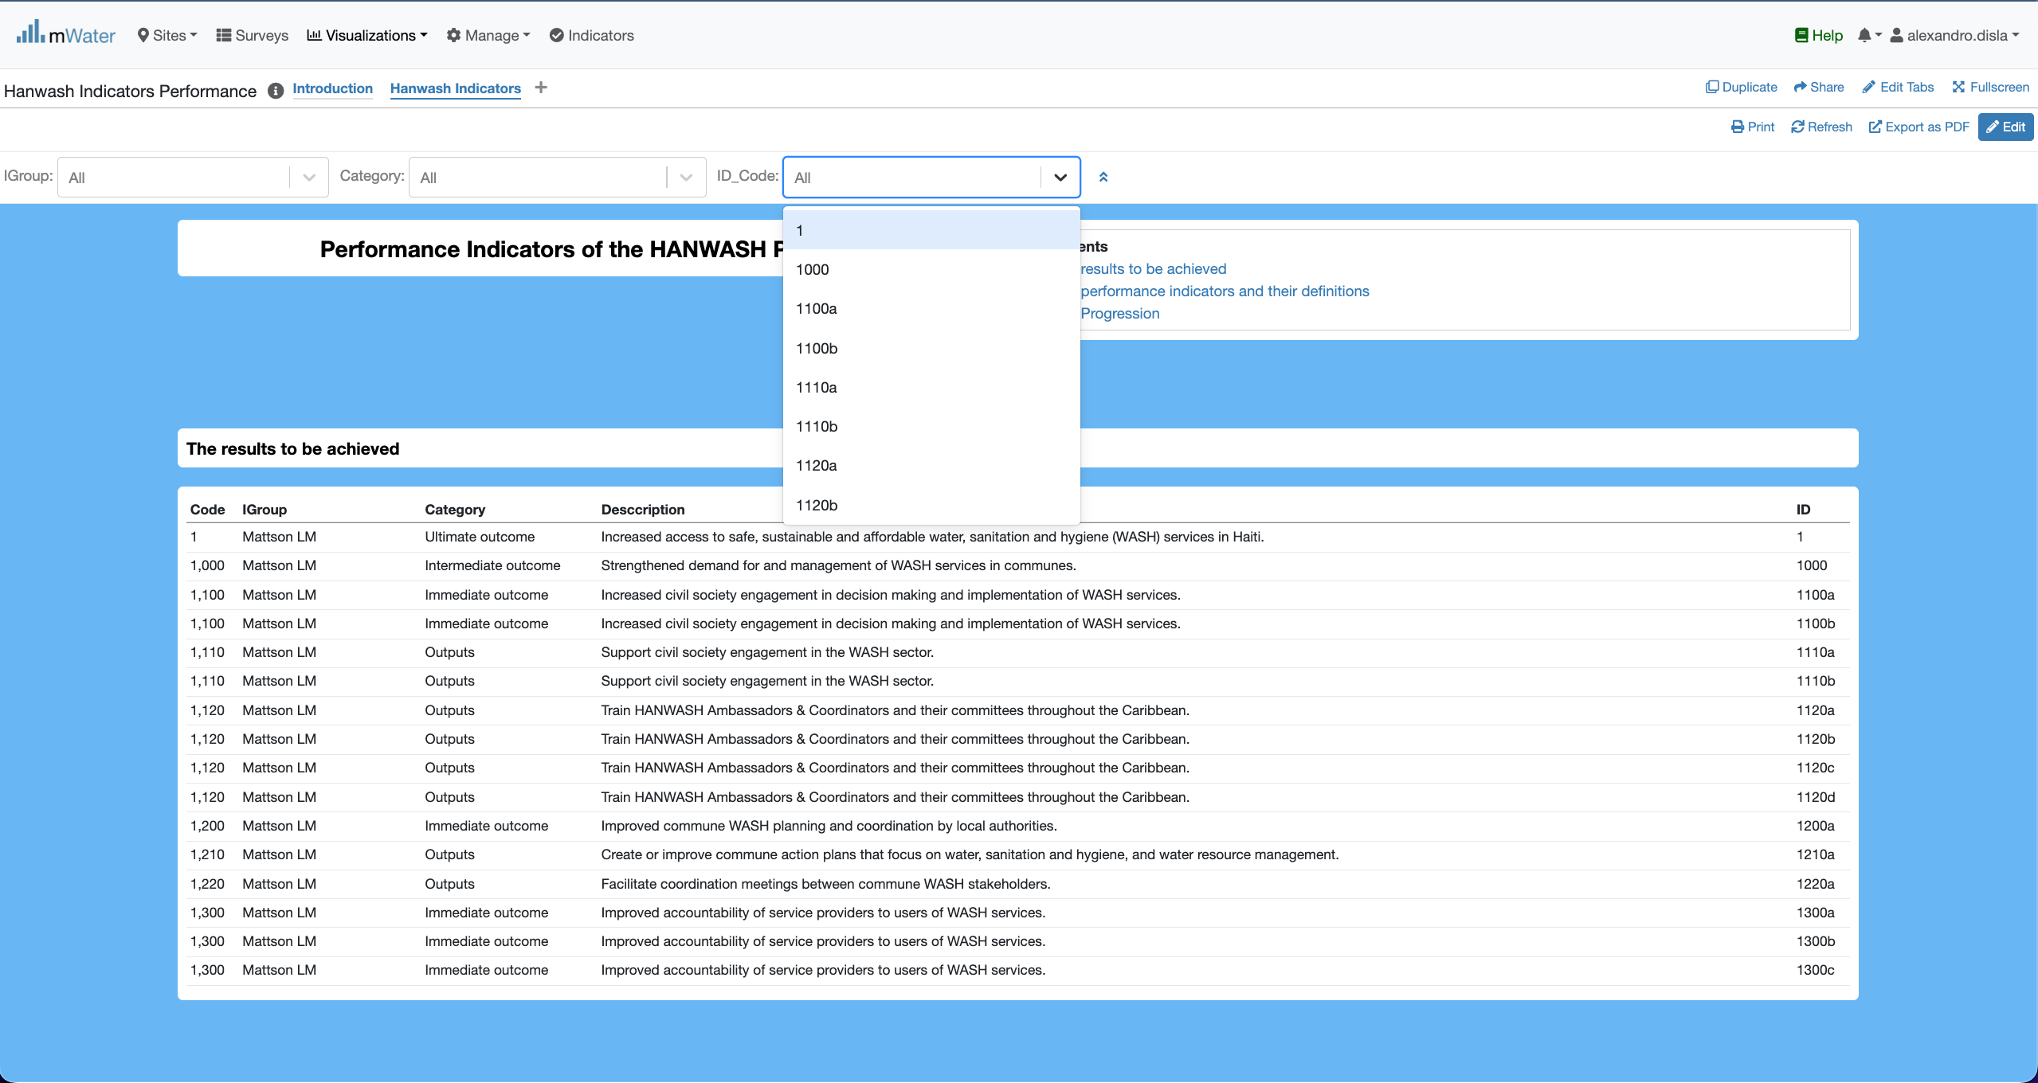
Display the quickfilters
The 3rd filter is the unique ID of the indicator.

Slide 18
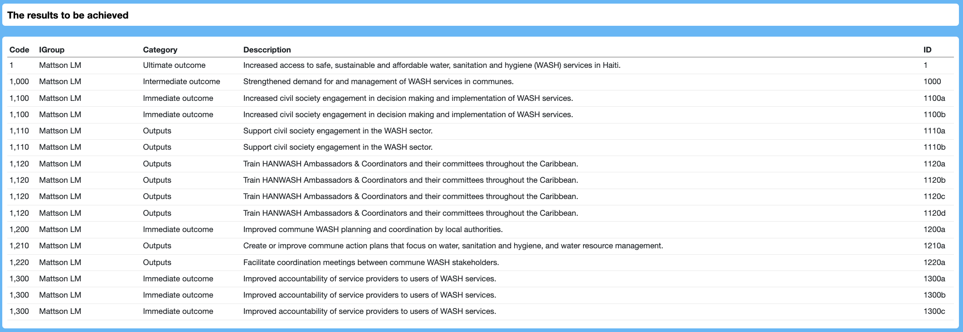
The Results table
Igroup, Category indicated the log frame which the results and indicators were defined
For each category of results, we have a proper definition
The ID is the unique identifier for each results and their corresponding indicator

Slide 19
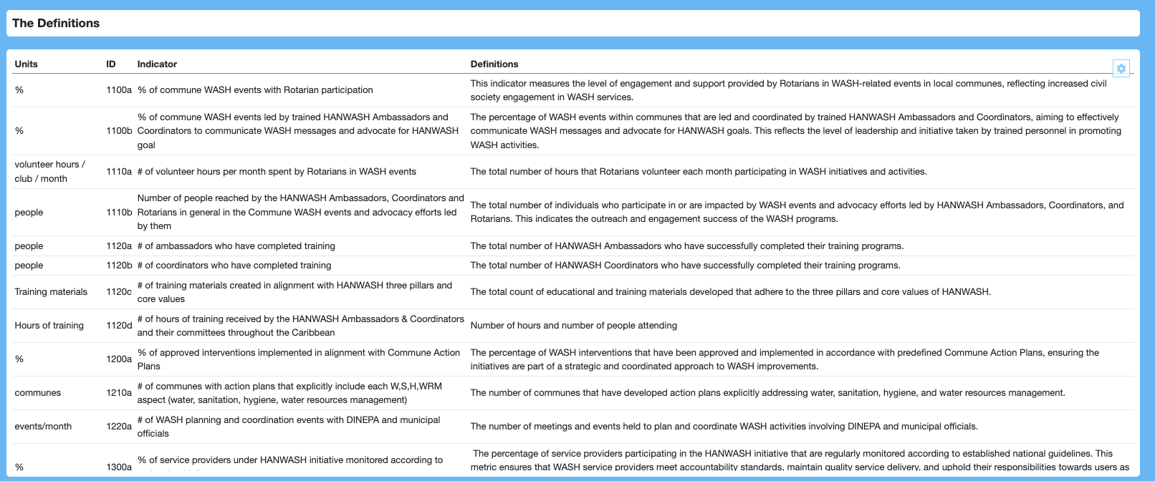
The indicator table
The units column to specify the unit of the indicator. The ID is under the complete control of the ID_code quick filter.
The indicators and their definition

Slide 20
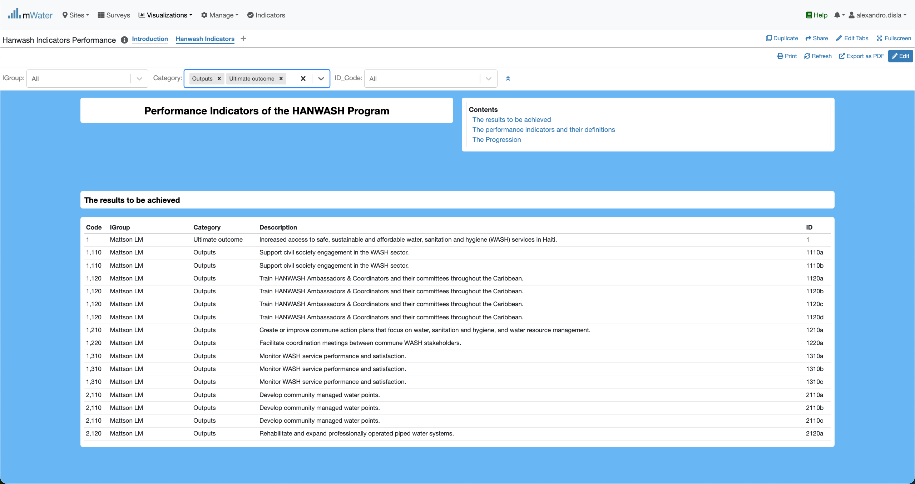
Category quickfilter effect
By design the category quick filter will allow you to select different categories and the section will behave to display the objectives, the definitions and the progression tables.

Slide 21
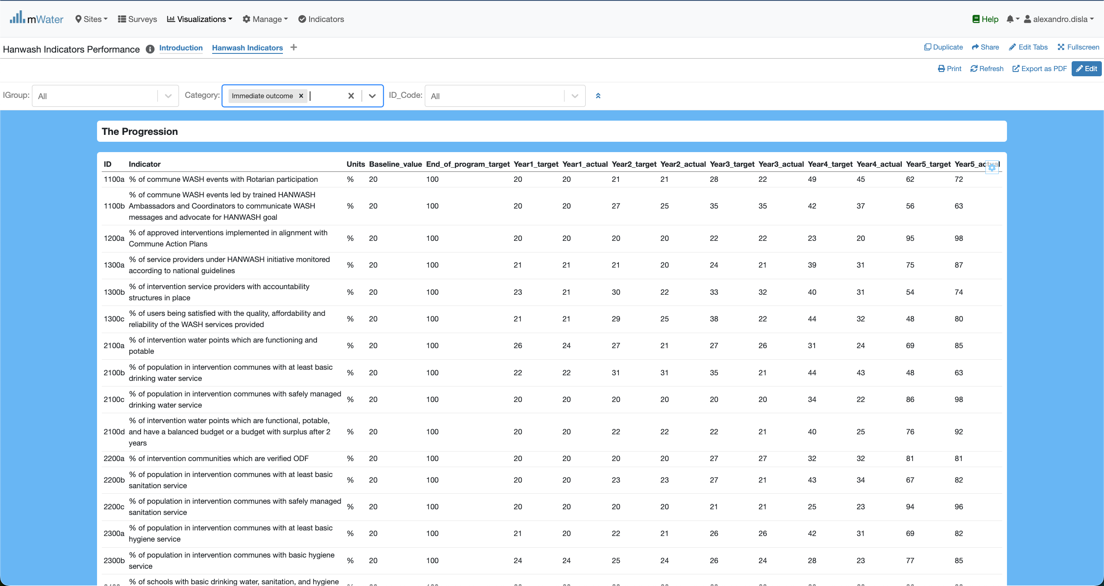
Category quickfilter effect
The Indicator table are show based on the category selected.
We have the baseline value. The end of program, expected, is used to set the year target. This numbers are generated randomly.

Slide 22
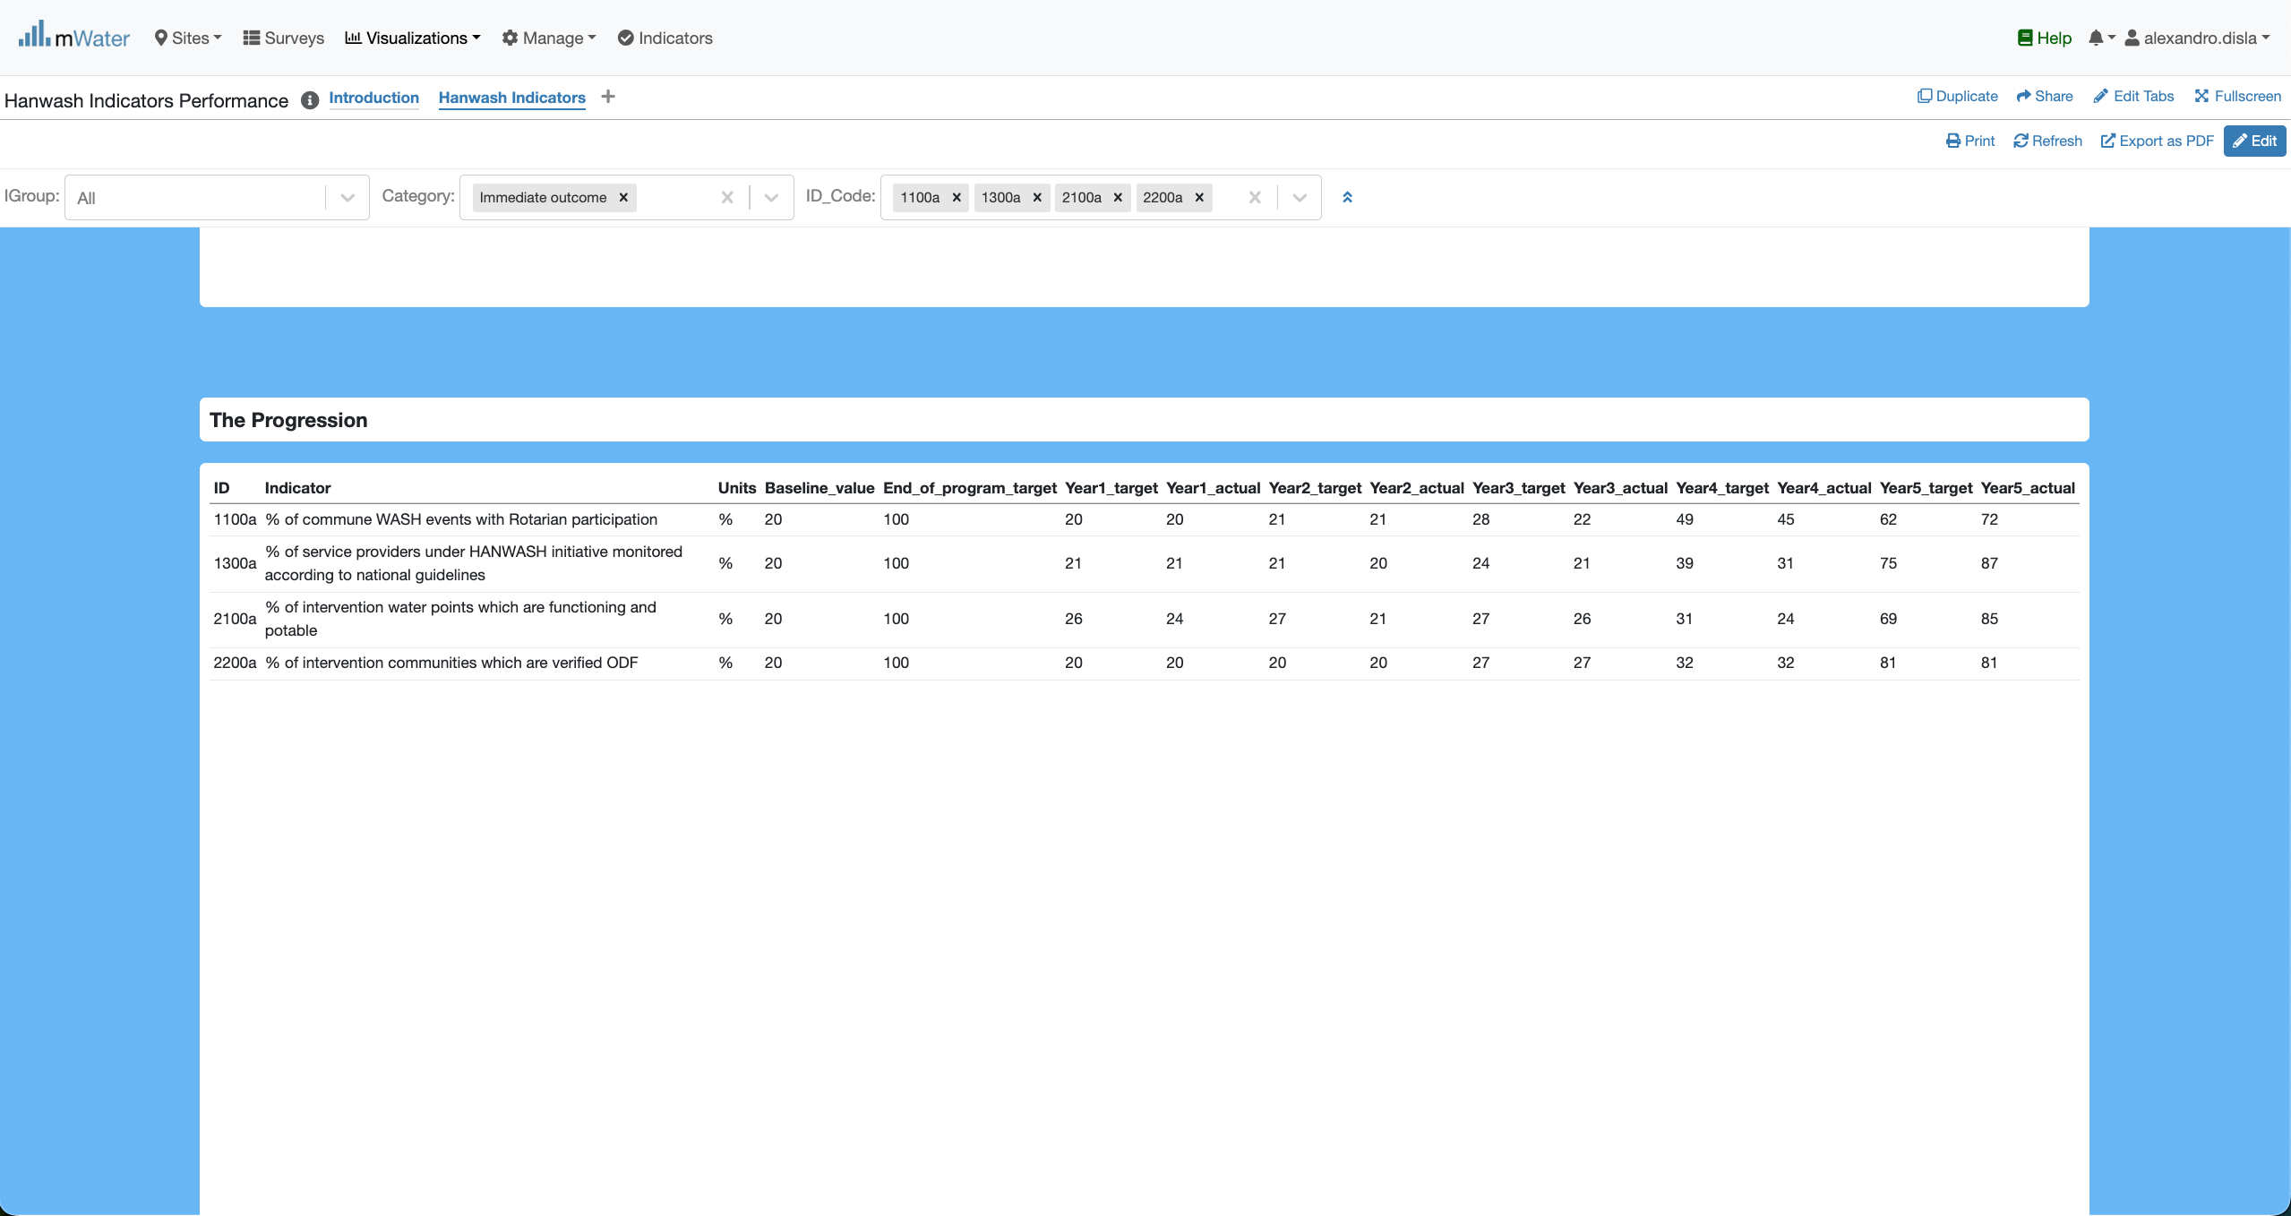
ID_Code quickfilter effect
Both designed to handle multiple choices. The table will reajust based on these choices.
Very practical if you just want to display a set of indicators.

Slide 23
Export
Export table as you need

Slide 24
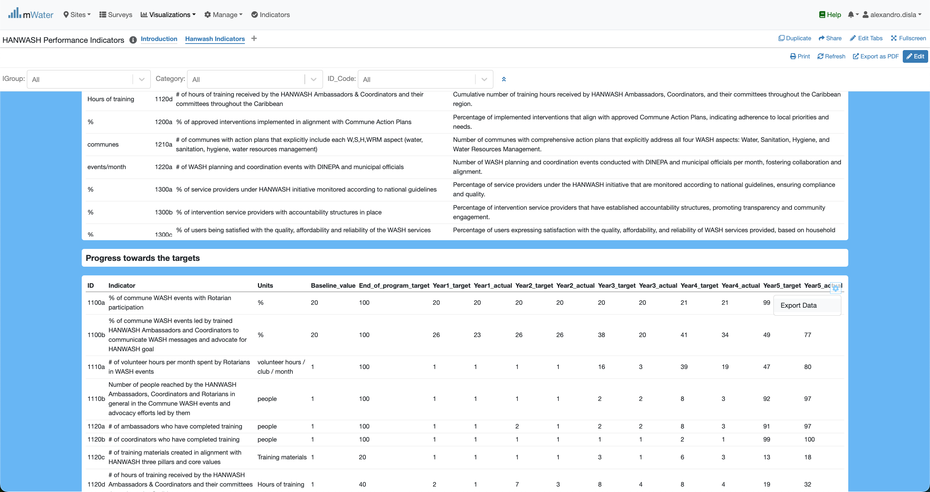
Export Table
This button: Export Data will open a portal.

Slide 25
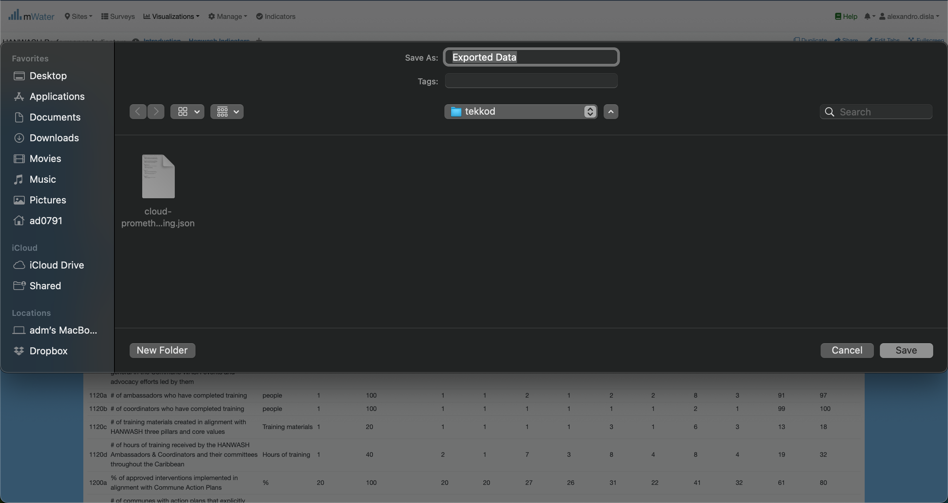
Export Table

Slide 26
Print Export
The print option is available for a global export.

Slide 27
Print Export
The print option is available for a global export.

Slide 28
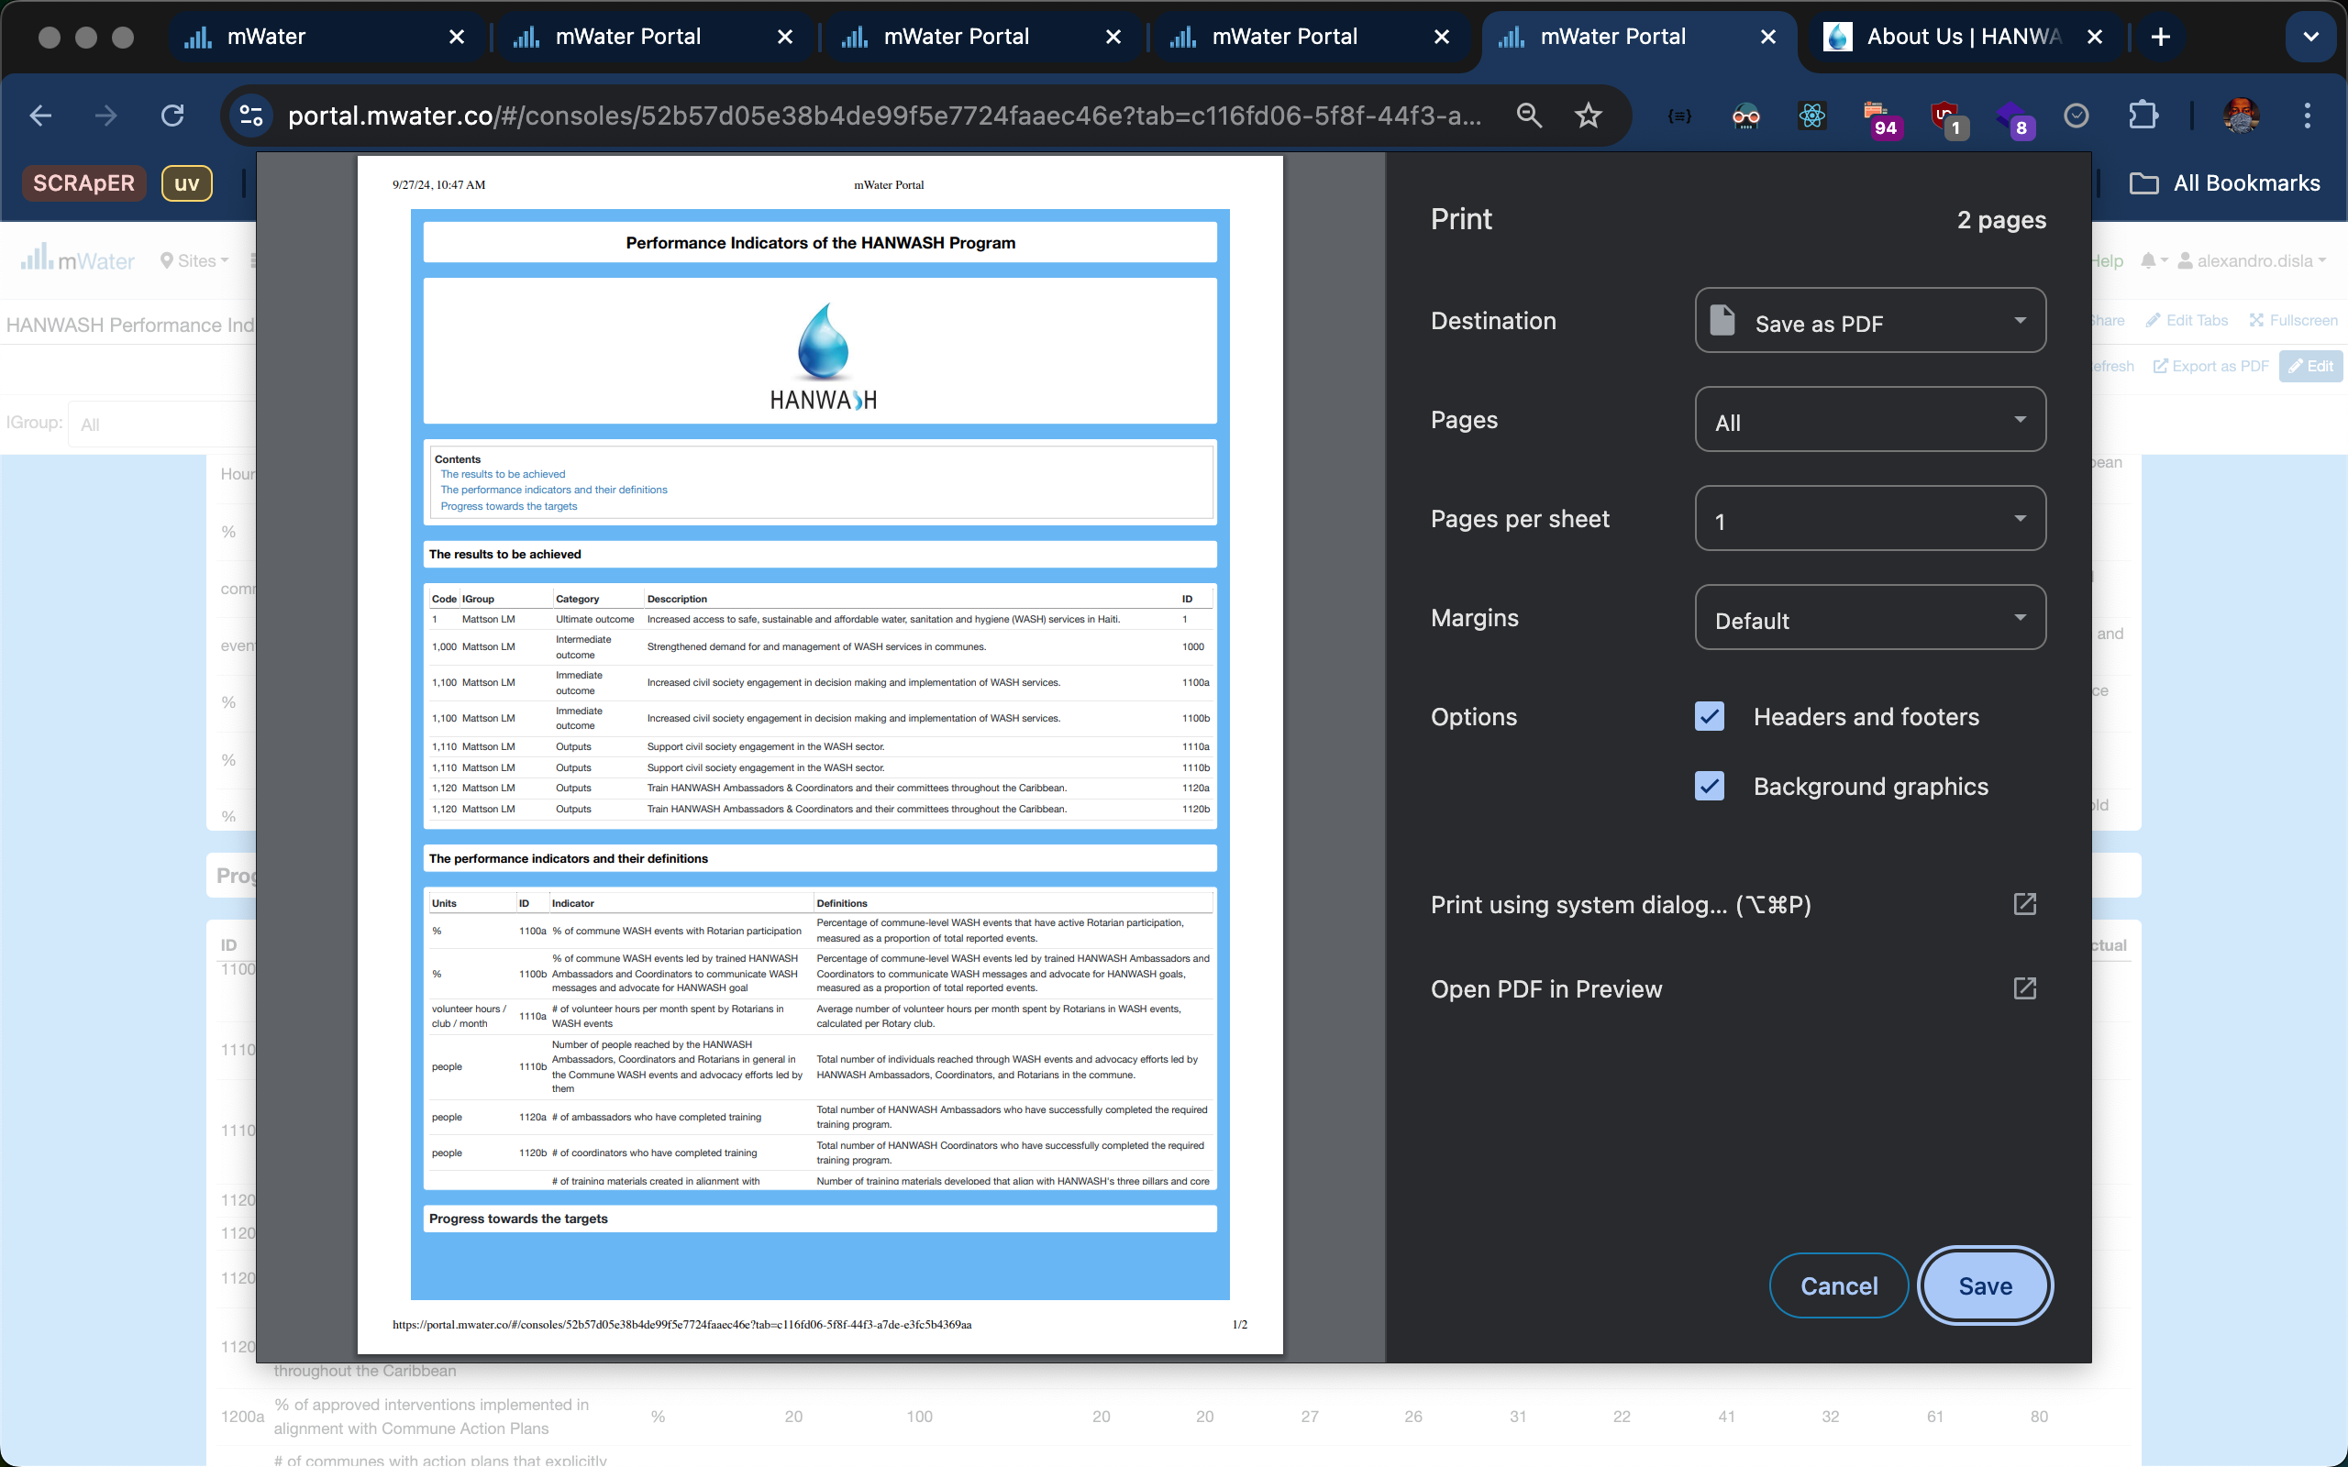
Print EXPORT

Slide 29
Thank You !!!
Contact textbox….

